Slide 1
Group 3
kwangryun Kim
seokjae Lee
seungsoo Lee
soyoung Park
Notes:
let me briefly introduce myself.
my name is seokjae lee.
today im going to talk about our group project

Slide 2
INDEX
Subject
Data
curation
Data
preprocessing
Producer
& consumer
Visualization
Aggregation
Notes:
this is the presentation index
i'll start with project description to data curation.
after that another student will continue the presentation

Slide 3


Subject
Aggregation on multiple datastream
Use currency history data for AU$ and US$, EU, GBP
Create a producer for each stream
Show the aggerate values for the dataset in one graph
Notes:
our subject is aggreation on multiple datastream
send currency data of us,eu,gbp based on AU
using spark and kafka.
Create three producers using kafka, and each producer sends exchange rate data to one consumer.
Finally, when the consumer receives the data, we visualizes it using python and matplotlib.

Slide 4

Data curation
US$
AU$
EU
GBP
Notes:
the data we want is the value of each currency based on au
for example, calculate the each currency value of 1 au.
so we found the dataset from kaggle.
but the dataset was not clean and purified. it has too much null value.
so we decided to collect data from exchange rate information site investing.com

Slide 5
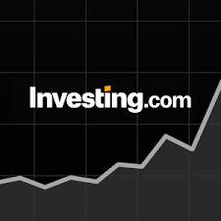
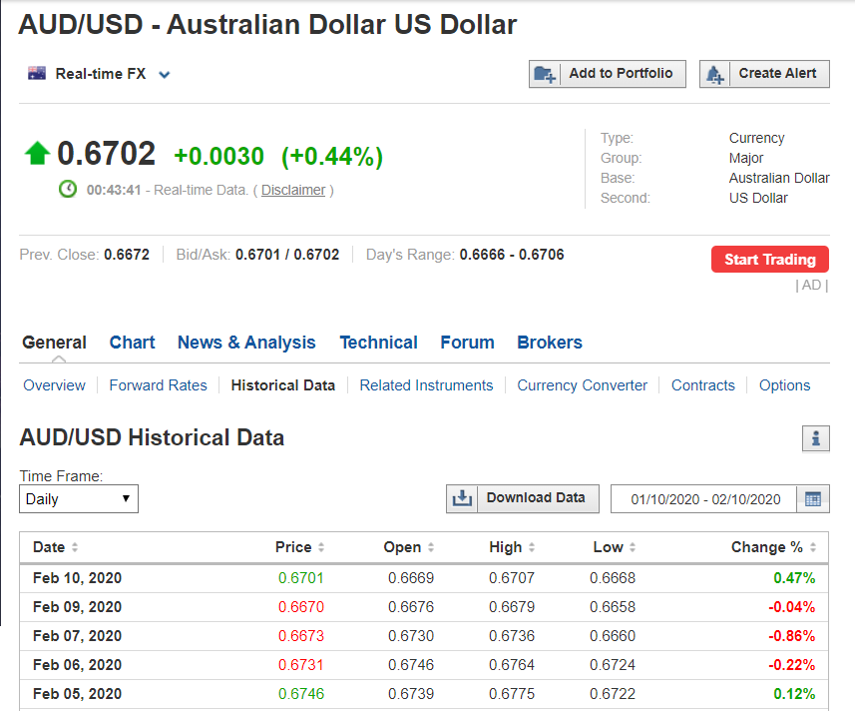
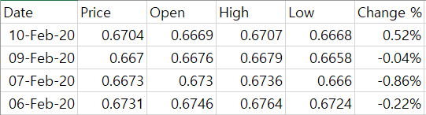
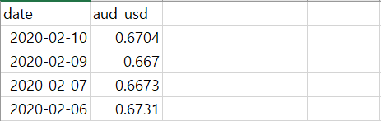
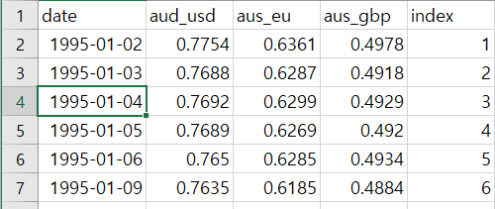
Data curation
Download
data
Drop without
‘Price’
Merge
Currency
&
Index
https://www.investing.com/currencies/aud-usd-historical-data
Result.csv
Notes:
when you access the page,
you can find and download the currency data which we want.
first download the csv, following image will appear.
we want the Price data only,
so drop the columns except Price.
than repeat the process for other currency.
and merge the result.

Slide 6
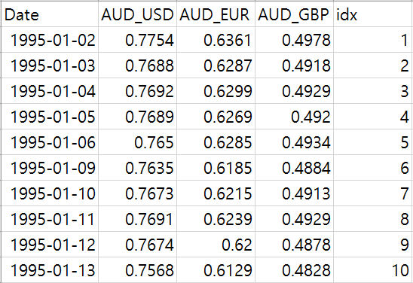
Data curation
Currency History reference: Investing.com
https://www.investing.com/currencies/eur-usd-historical-data
Rows: 6481
Columns: 5
1995-Jan-02 ~ 2018-Jun-24
Date(date)
AUD_USD(float)
AUD_EUR(float)
AUD_GBP(float)
idx(int)
Notes:
as a result, we get this dataset
with following date, currency value, and index.
and now i'd like to hand over to other student.

Slide 7
Algorithm
Kafka Realtime Streaming
Producer
If e<range
Program
Start
USD exchange rate
EUR exchange rate
GBP exchange rate
Load CSV data
Transit
USD, EUR, GBP data
Consumer
No
If CSV data end
END
Draw
plot
Receive
Data1,2,3
Yes

Slide 8

Data preprocessing
Add index
To set a date as the basis for an alignment
But date is a string type
Use index as a basis for an alignment

Slide 9
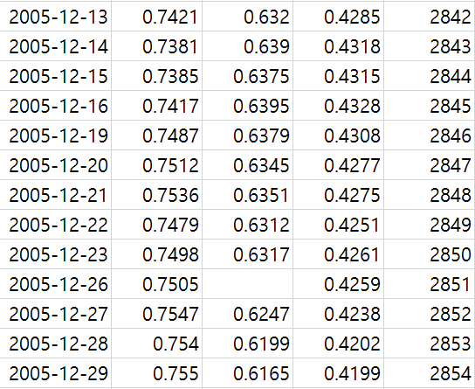
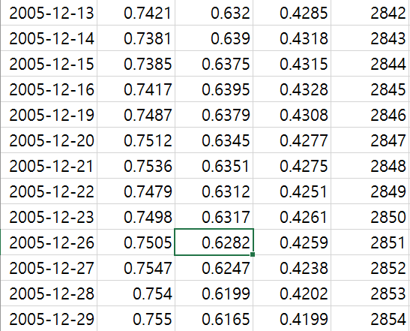
Data preprocessing
Missing value
On some days, the value does not exist
Fill it up with the average value

Slide 10


Producer & Consumer
‘US’, <value>
US$ based on AU 1$ date
‘EU’, <value>
EU based on AU 1$ date
‘GBP’, <value>
GBP based on AU 1$ date

Slide 11
Visualization
counter
If counter >5
counter
Draw plot!

Slide 12
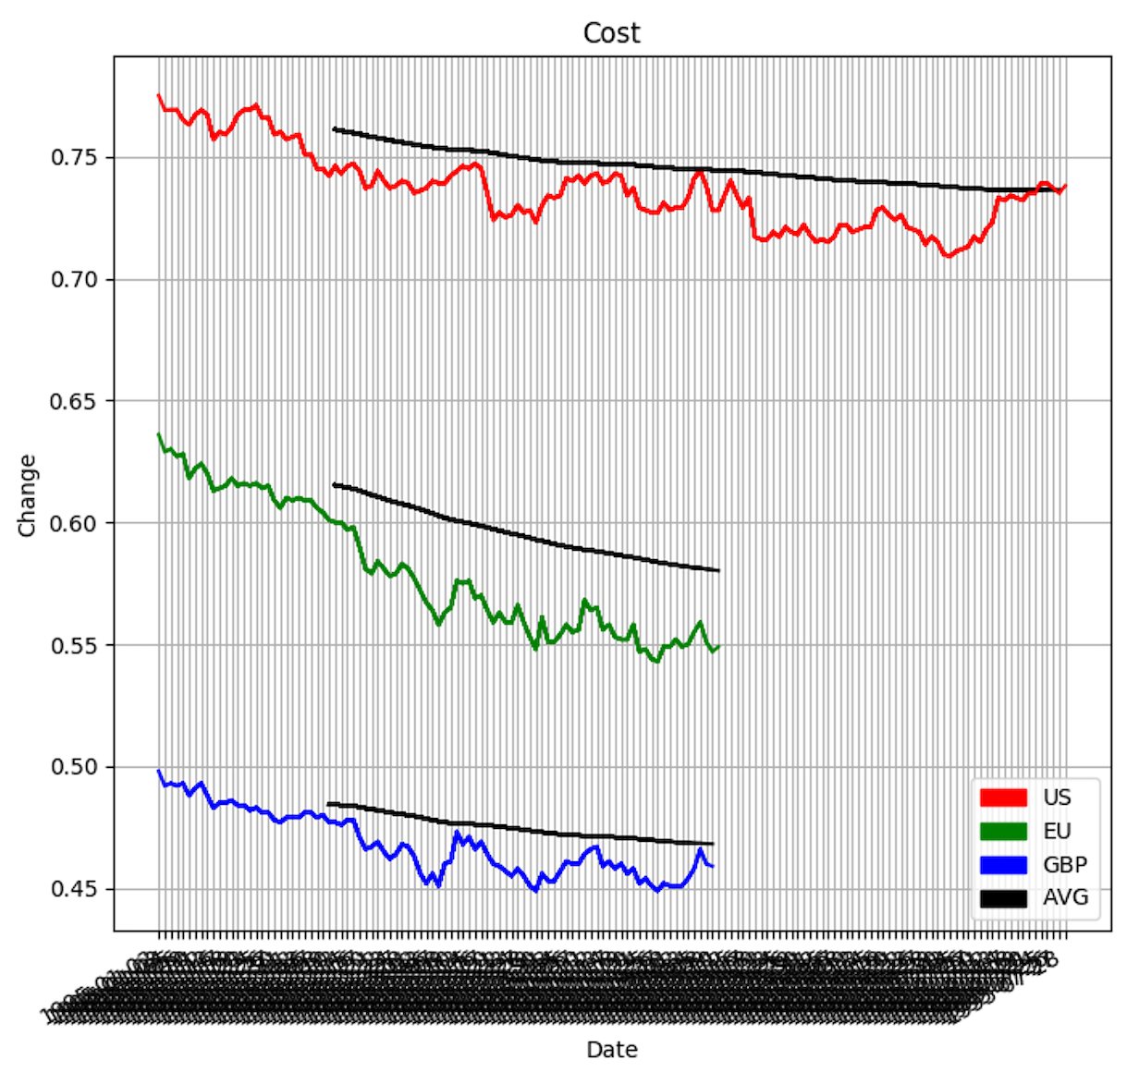
Aggregation
Monthly average of each currency

Slide 13
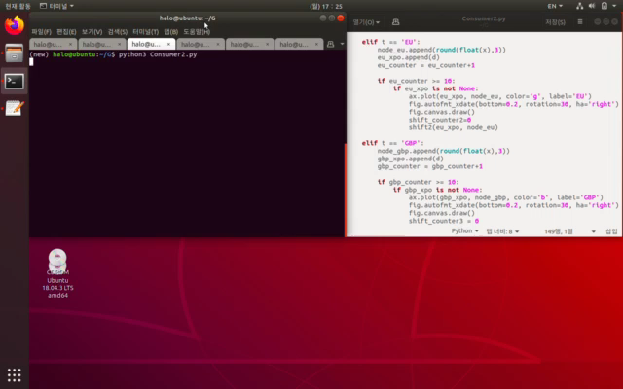
Demo

Slide 14
Thank you

